Slide 1
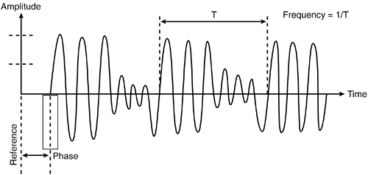
EG431D Data Acquisition
Signal Fundamentals and Acquisition Methods

Slide 2
Objectives
Describe stationary and non-stationary signals and their impact on signal processing.
Explain the Nyquist-Shannon Sampling Theorem, aliasing, and quantization.
Demonstrate signal acquisition methods for various signal types.

Slide 3

Introduction to Signals
Definition of signals: Information varying over time/space.
Types: Analog (continuous) vs. Digital (discrete).
Characteristics: Amplitude, frequency, phase.
Stationary vs. Non-Stationary signals.

Slide 4
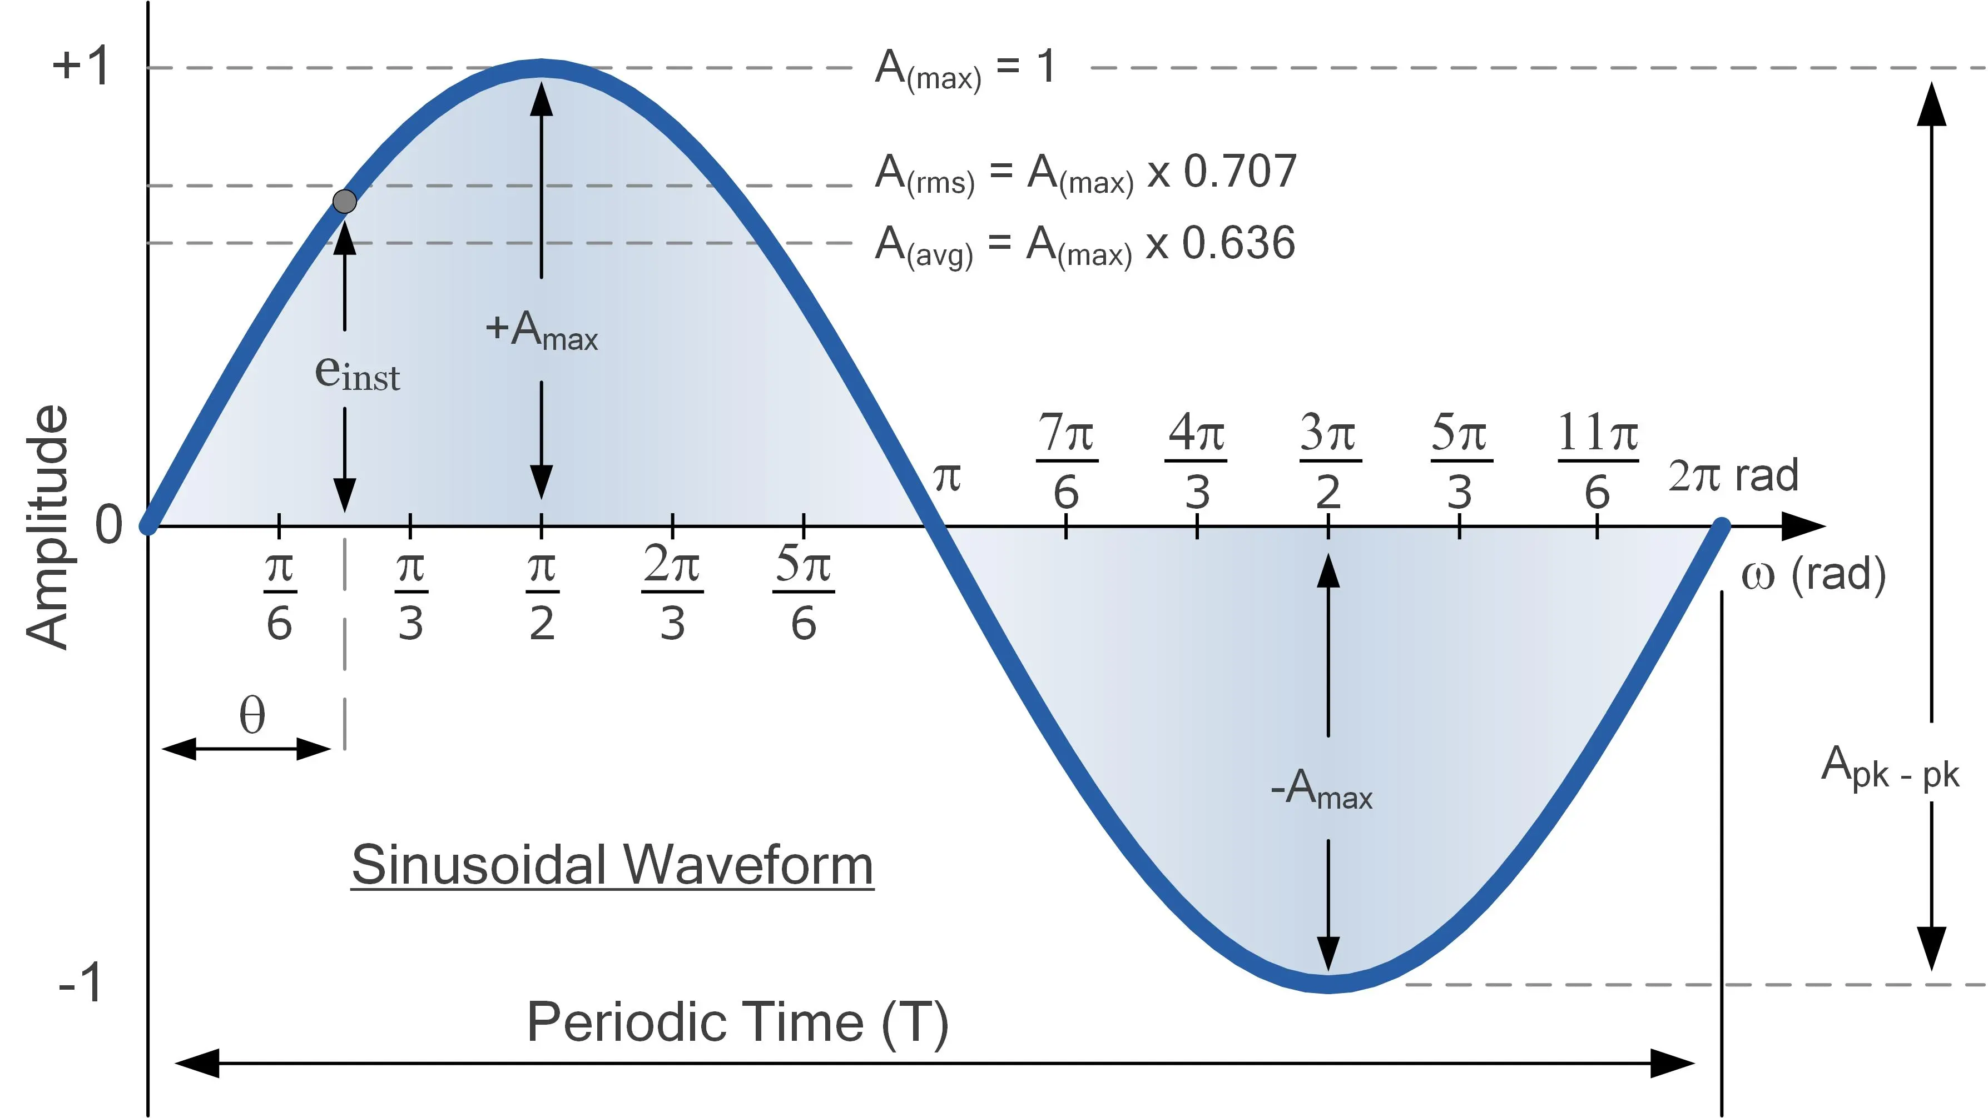
Stationary Signals
Definition: Statistical properties constant over time.
Types:
Strict-Sense Stationary (SSS): All moments invariant.
Wide-Sense Stationary (WSS): Mean and autocorrelation invariant.
Examples: Pure sine wave, thermal noise.

Slide 5
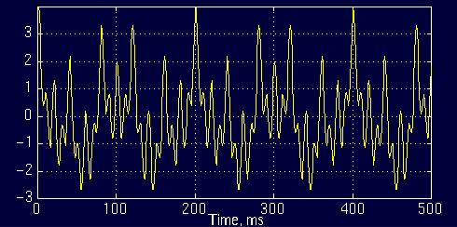
Non-Stationary Signals
Definition: Statistical properties vary over time.
Examples: Speech signals, ECG, seismic data.
Analysis methods: Short-time Fourier Transform, wavelet transform.

Slide 6
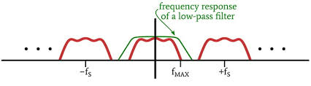
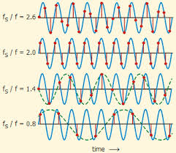
Sampling Theorem
Nyquist-Shannon Sampling Theorem:
Sampling frequency ≥ 2 × max frequency.
Prevent aliasing.
Importance of anti-aliasing filters.

Slide 7
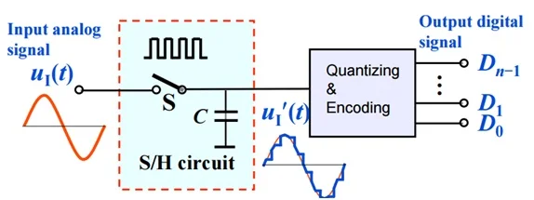
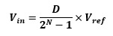
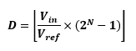
Analog-to-Digital Conversion (ADC)
Steps: Sampling, Quantization, Encoding.
Key parameters: Resolution, sampling rate, reference voltage.
Types: SAR, Delta-Sigma, Flash ADC.

Slide 8
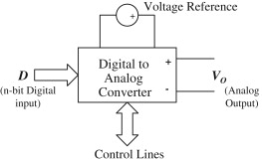
Digital-to-Analog Conversion (DAC)
Process: Converting digital data to continuous analog signals.
Types: R-2R Ladder, Delta-Sigma, PWM.
Applications: Audio systems, motor control.

Slide 9
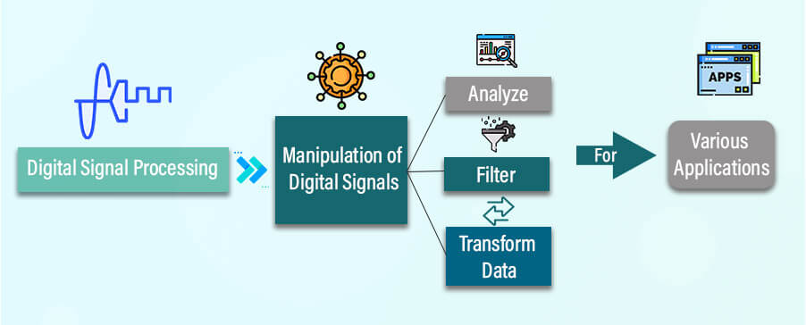
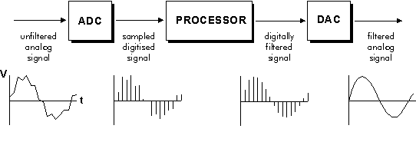
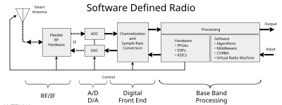
Digital Signal Processing (DSP)
Operations: Filtering, Fourier Transform, modulation.
Applications: Noise cancellation, biomedical imaging, communication systems.

Slide 10
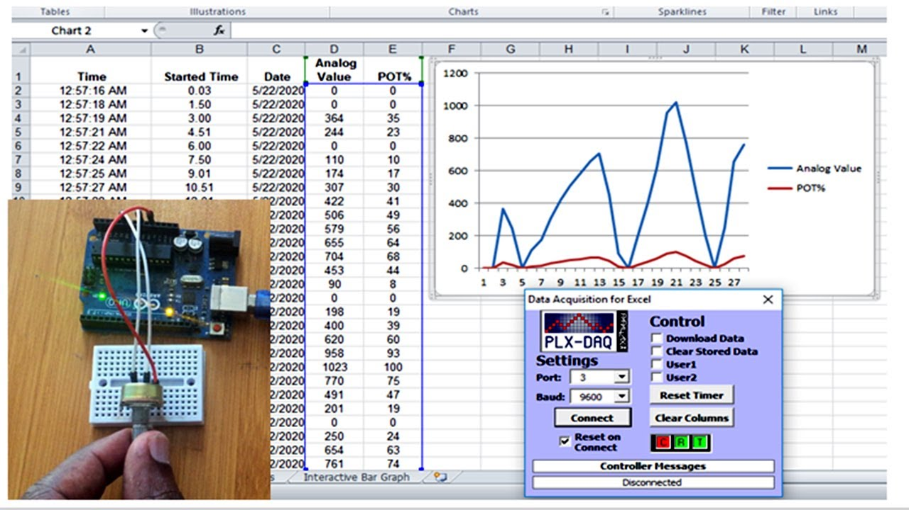
Signal Acquisition with Arduino
Low-speed vs. high-speed acquisition.
Tools: analogRead(), digitalRead().
Examples:
Condition-based monitoring for predictive maintenance.
Home occupancy monitoring for elderly care.

Slide 11
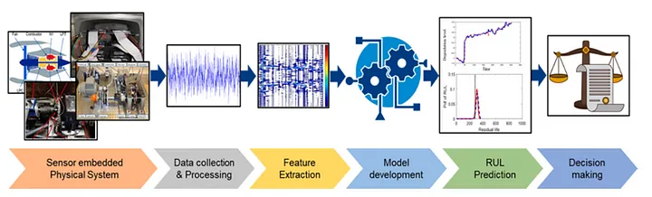
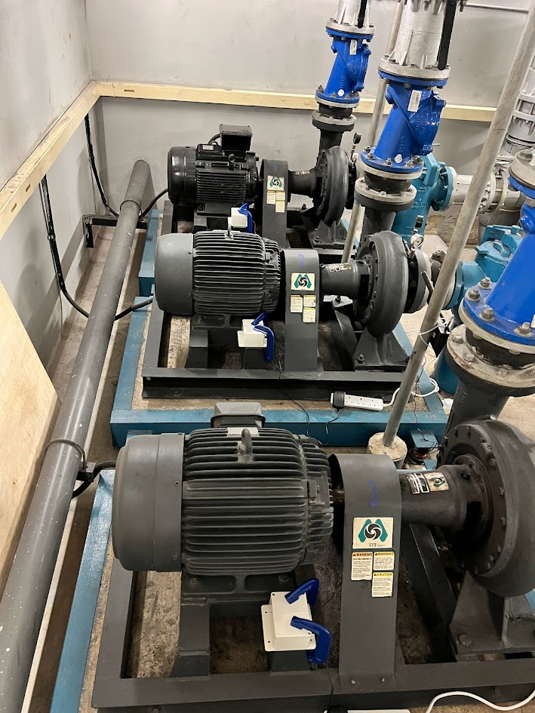
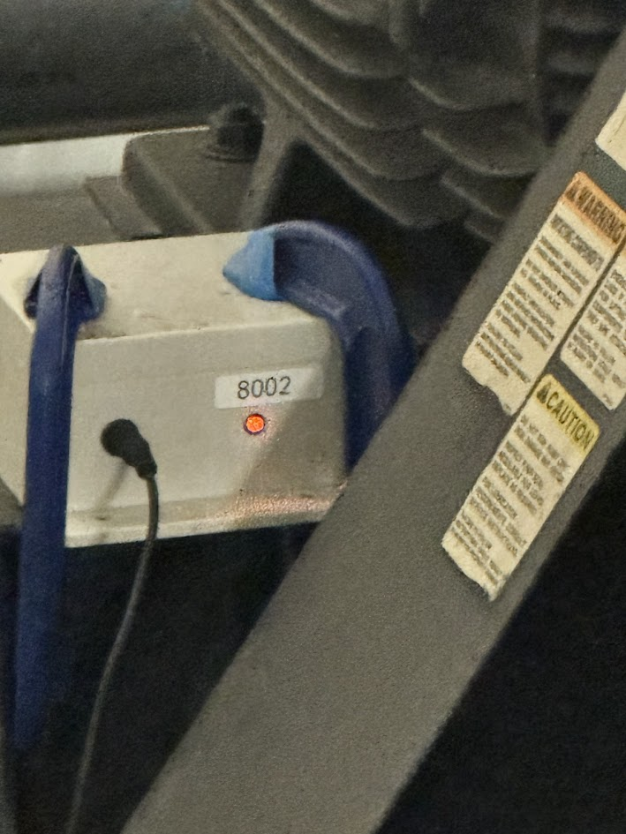
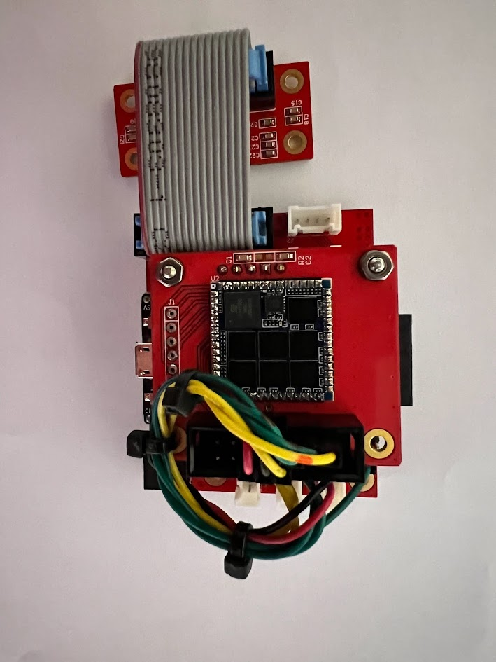
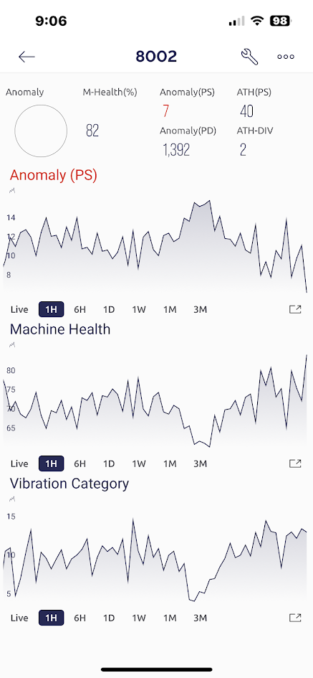
Case Study: Predictive Maintenance
Sensors: Accelerometer, sound, thermal array.
Analysis: Vibration, sound anomalies, thermal hotspots.
Benefits: Reduced downtime, cost efficiency.

Slide 12
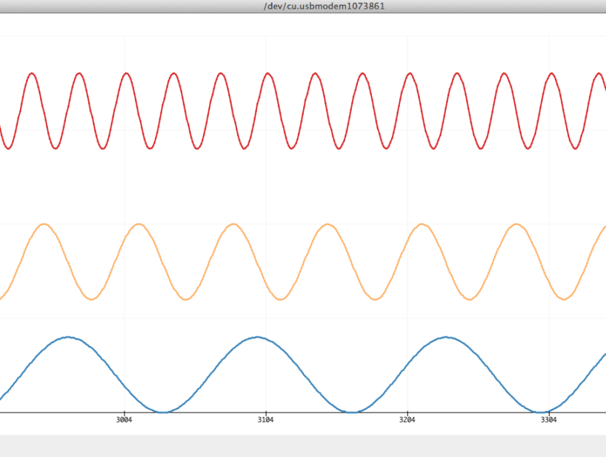
Summary
Key Takeaways:
Importance of understanding signal properties.
ADC/DAC fundamentals.
Practical applications of signal acquisition.
Questions for reflection:
How do signal types affect processing techniques?
What are the challenges in high-speed signal acquisition?

